Slide 1

Text Analytics Workshop
Devin L Johnson, Ph.D.
nycsodata24.sched.com #nycSOdata #opendataweek

Slide 2

Overview
Intro to open ended text data
Common methods of exploring text data
Strengths and Limitations
Guided Workflow
Structuring text data for analysis
Descriptive explorations
Sentiment Analysis
Word correlations and Node Maps
Q&A

Slide 3

About Me
Data Science Educator
PhD in Experimental Psych
Data Analyst in Market and Higher Ed Research
Devin Johnson

Slide 4
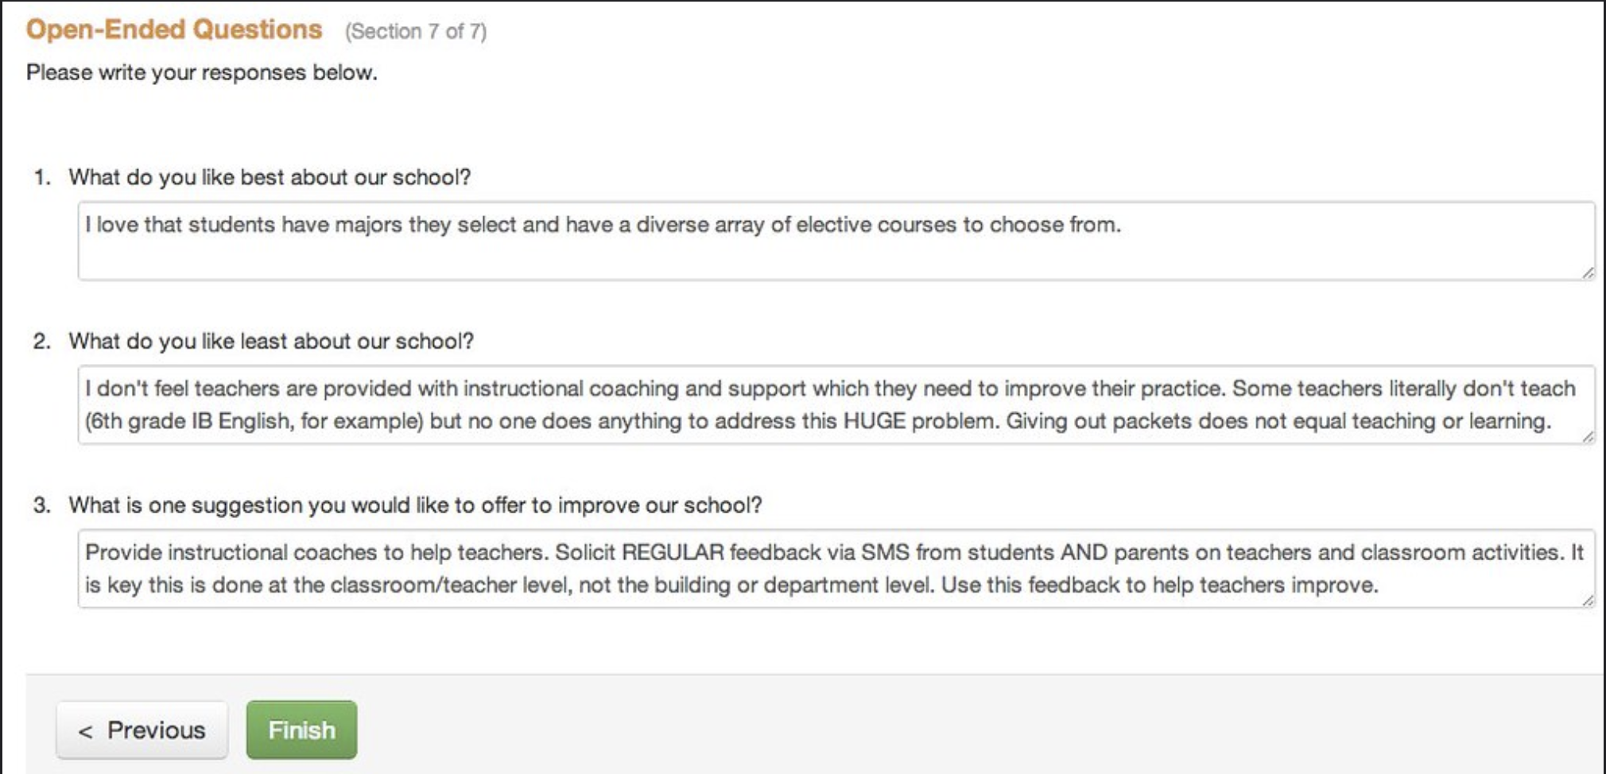
Text data everywhere
Experiments with writing prompts
Surveys with reviews or comments
Today’s example: City Emergency Notifications

Slide 5
What do we do with this data
Short form text data usually ignored or skimmed briefly
Often times too vast to meticulously analyze
By ignoring we miss potentially useful info

Slide 6

Framework
Tidy text analysis (Silge & Robinson, 2017)

Slide 7
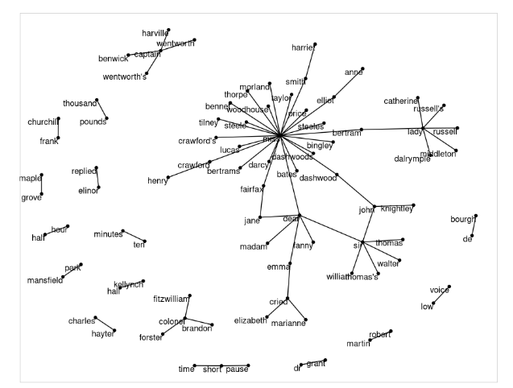
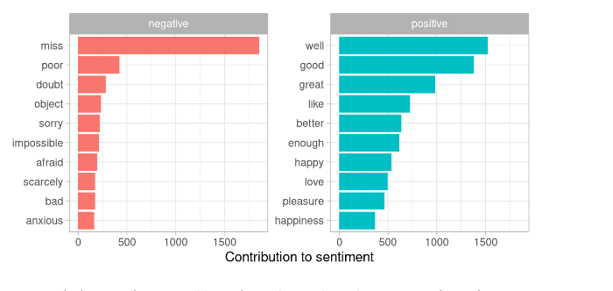
Examples
Descriptive plots
Sentiment Analysis
Word correlations / Node Maps
Topic Modeling

Slide 8
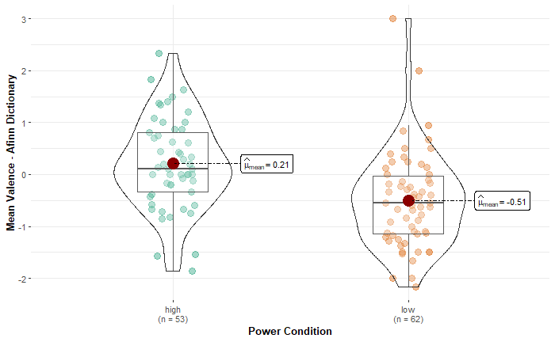
Examples in research
Identifying relevant psychological information
How do people talk about themes such as power and dehumanization
Exploring how students and teachers think about assessments
Training students to think quantitatively and qualitatively about language data

Slide 9
Friendly reminders / Caveats
Useful to “scratch the surface”
Can inspire further qualitative analysis not replace it
Own subjective component (researcher degrees of freedom) of these methods

Slide 10
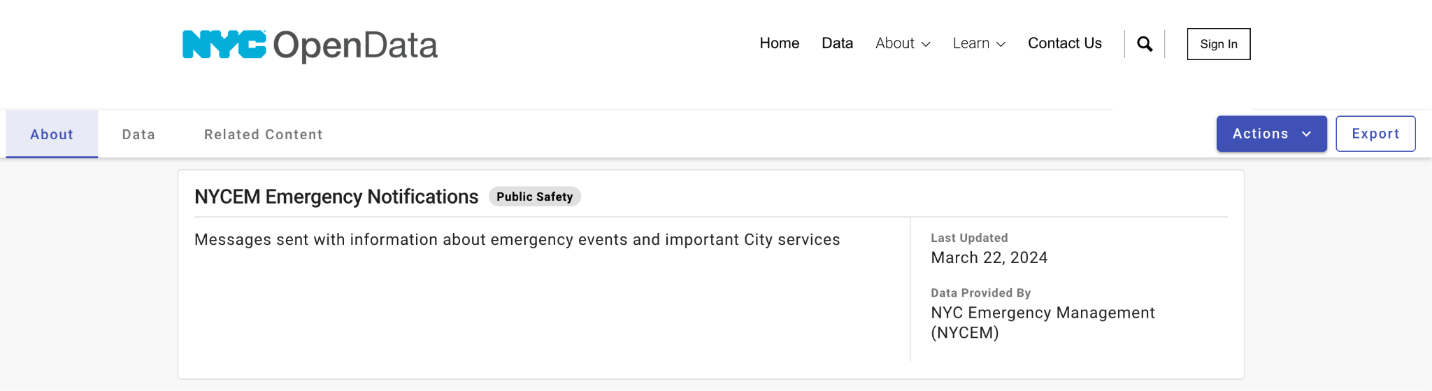
Let’s Get Started!

Slide 11
Additional Resources
https://www.tidytextmining.com/ - Text Mining in R book
https://www.youtube.com/watch?v=evTuL-RcRpc – Topic Modeling Demo
https://github.com/johnson-dl/school-of-data-2024-text-analytics - Github repo for analysis notebook

Slide 12

Thank you!
Stay in touch at beta.nyc/links
linkedin.com/in/devinljohnson/
nycsodata24.sched.com #nycSOdata #opendataweek

